Slide 1
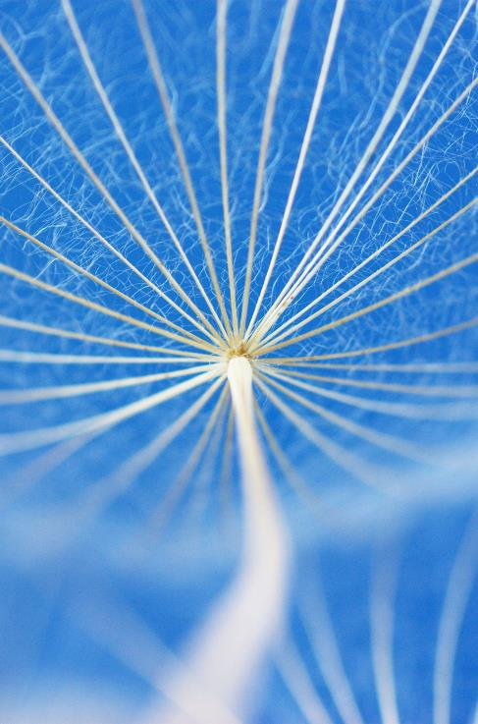
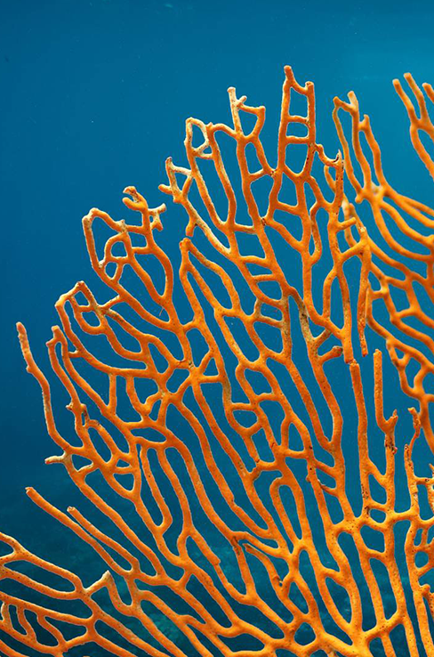
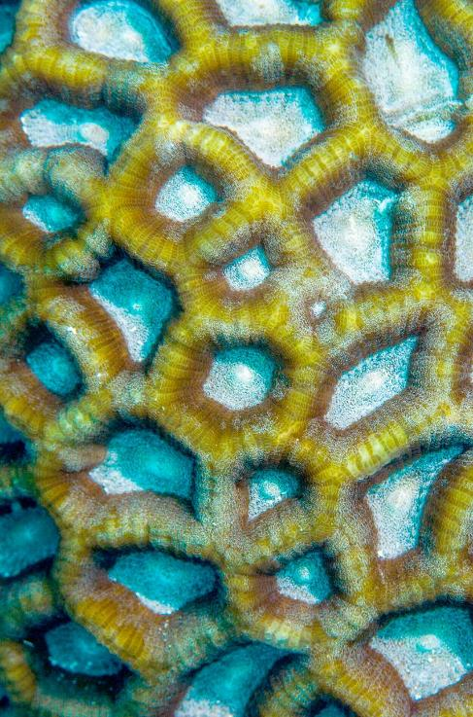
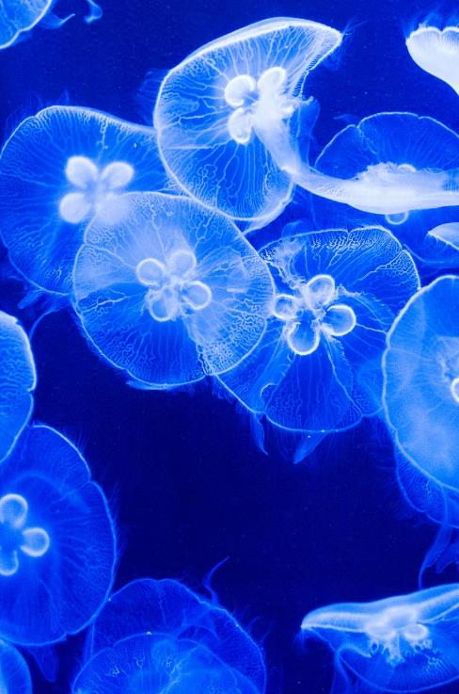
Why You should drink more water
Jay Lee

Slide 2
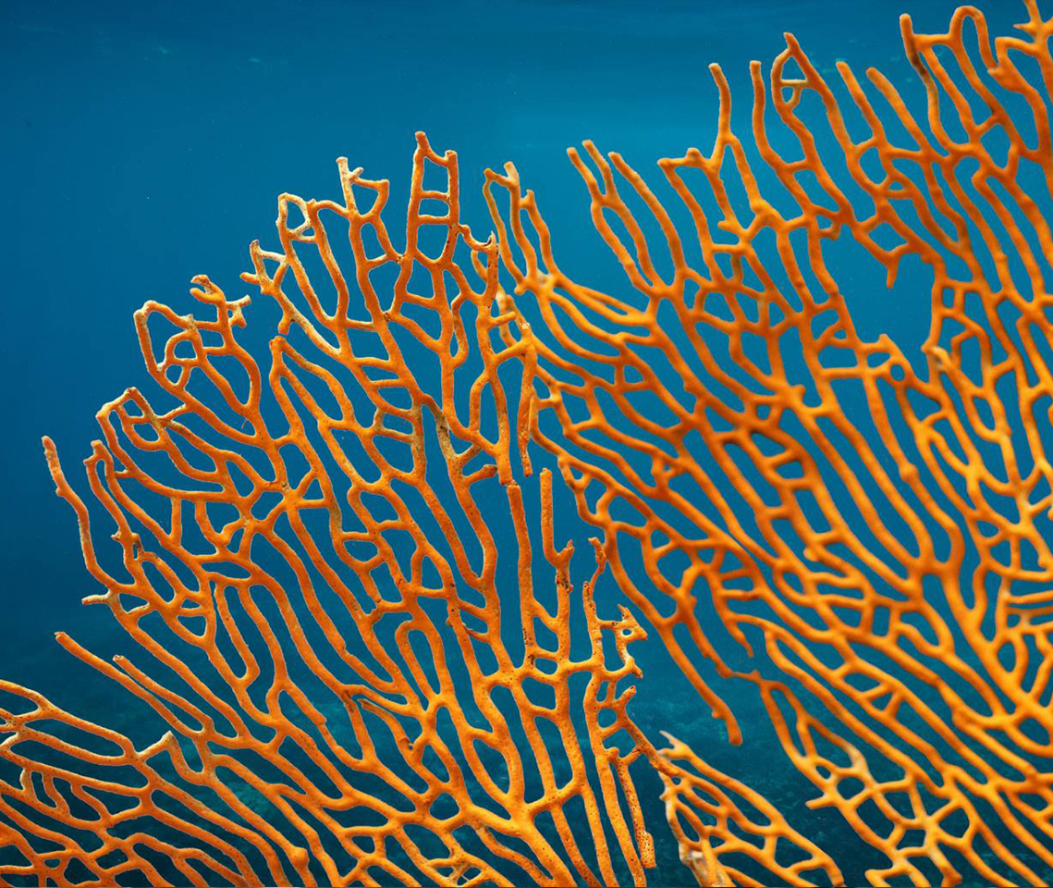
STRUCTURE
Introduction
Health Conditions
Hydration Benefits
Alternatives for Water
Summary

Slide 3
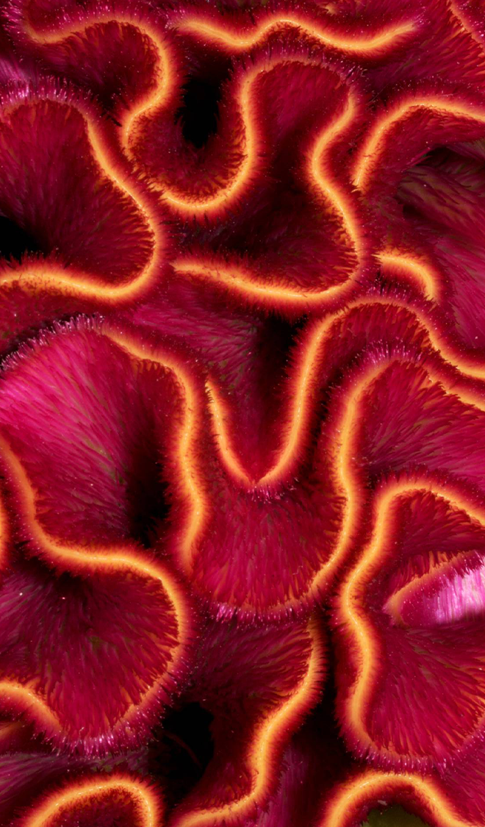
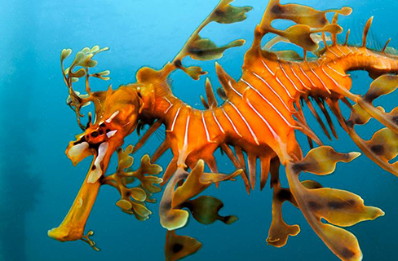
How do you feel?
How do you feel morning after binge drinking?
How do you feel after an intense workout?
Have you thought about the reason why you might be in pain?
Reason you feel nausea, dizzy, and thirsty is because your body requires more water than what you currently have.
Let’s take a closer look at what hydration and dehydration can do to you

Slide 4
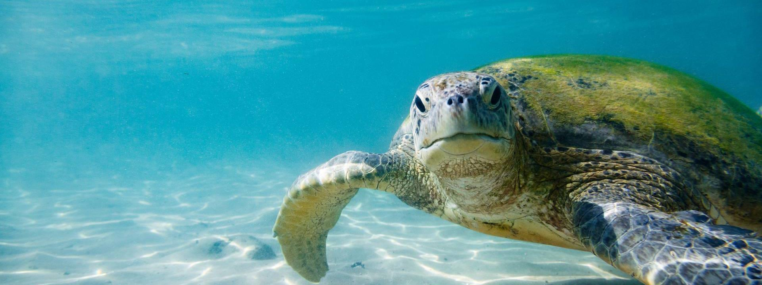
Health conditions due to dehydration
Short & Long term side effects

Slide 5
Short Term effects
Lack of concentration
Mood Control
Even a mild dehydration, such as 1-3% of body weight can impair many aspects of brain function
In a study in young women, researches showed fluid loss of 1.4% impaired both mood & concentration
Research shows that water is important for maintaining your mental health
Dehydration may increase your risk of anxiety and depression

Slide 6
Long Term effects
Dizziness / light headedness
Sleepiness / Fatigue
Temperature Regulation
Dehydration impacts blood volume directly.
With the lack of blood volume, you will experience dizziness and light headedness
This is due to your brain not supplied with enough blood
Sleepiness and fatigue is also closely related to blood volume level
When your body is low on fluids, your body struggles to replenish the water your body loses through out the day
Causing fatigue and sleepiness
The body water has an important role as a thermoregulator
If the body becomes too hot, water is lost through sweat and the evaporation of this sweat from the skin surface removes heat from the body

Slide 7
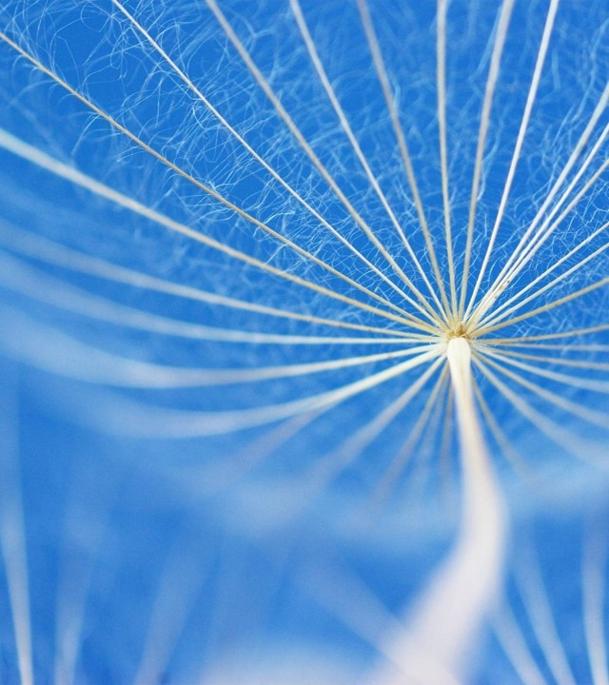
Benefits of staying hydrated
Why You Should Stay Hydrated

Slide 8
Benefits of staying hydrated
Aesthetic Benefits
Health Benefits
Direct correlation with skin health
Impact on hair and eye
Healthier complexion
Skin, eye, and kidney health benefits
Performance increase due to blood volume increase
Less fatigue and increased concentration

Slide 9
Are you drinking enough water?
Mildly hydrated. Optimal amount of water for little kids
You won’t live for long
Well hydrated
0 cups
3 – 5 cups
11 – 15 cups
1 to 3 cups
8 – 11 cups
8 – 24 oz of water. Very dehydrated.
Mildly hydrated for men, optimal amount for most women

Slide 10
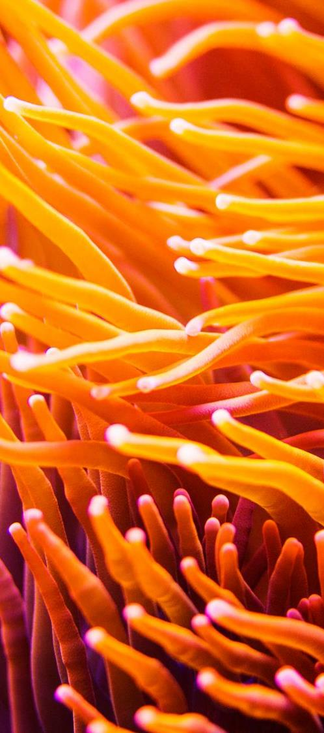
Alternate for water
What is a good substitute for water?
Are these options viable?
Sparkling Water
Infused Water
Aloe Vera Juice
Coconut Water
Cactus Water
With an exception of Sparkling water, water can not be substituted 100%
Having that said, these options still are a great choice of beverage to keep yourself to replenish and rehydrate

Slide 11
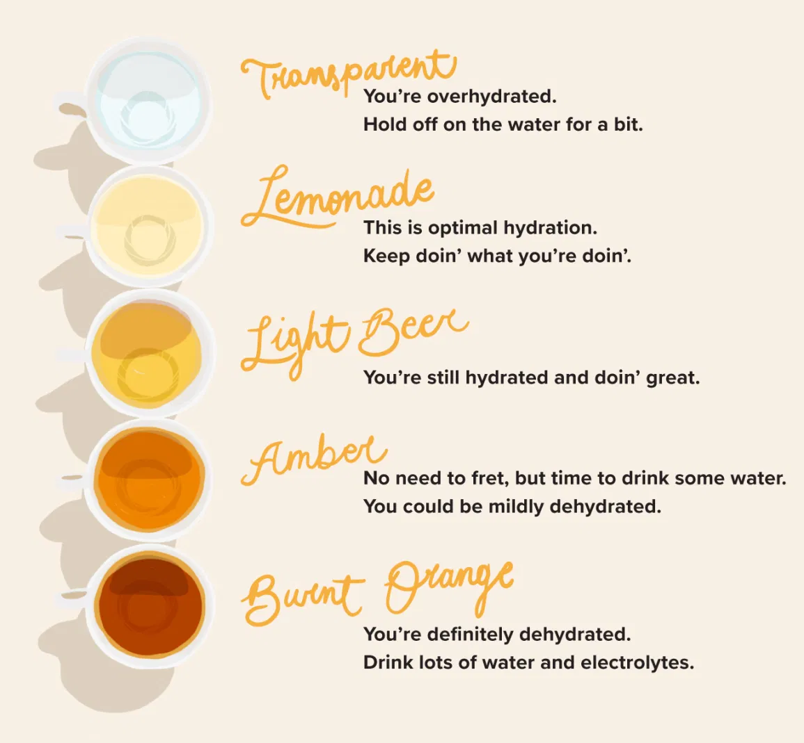
Urine Hydration chart
Color of your Urine can be a great hydration indicator
Not all cups are exactly 8 oz
Measuring hydration based on cups of water can be hard since everyone requires different amount of water
Take a look at the image on the left and self diagnose yourself
Are you hydrated?

Slide 12
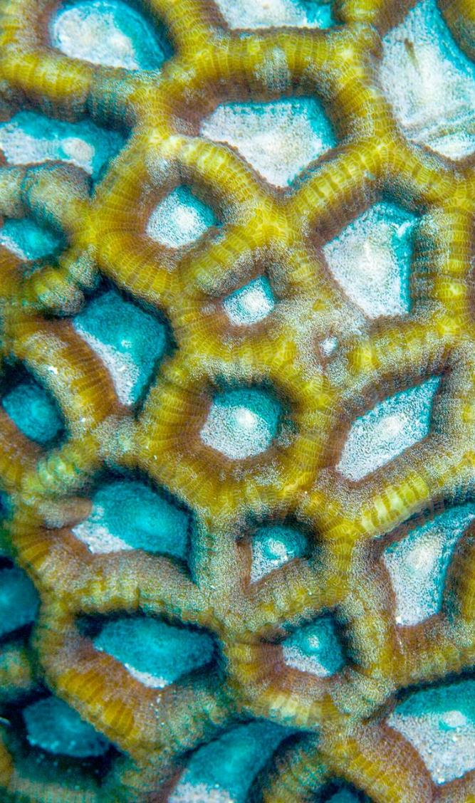
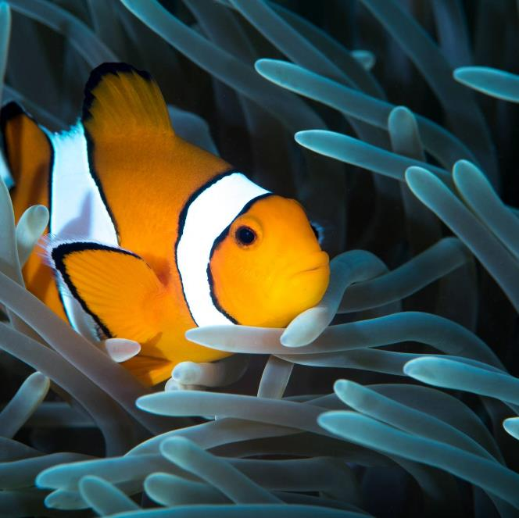
SUMMARY
Are you looking for a way to stay healthy?
Staying hydrated is the easiest way to enhance your health
Staying hydrated comes with many benefits and stay away from malicious sideeffects of dehydration.
Drink more water and stay hydrated!

Slide 13
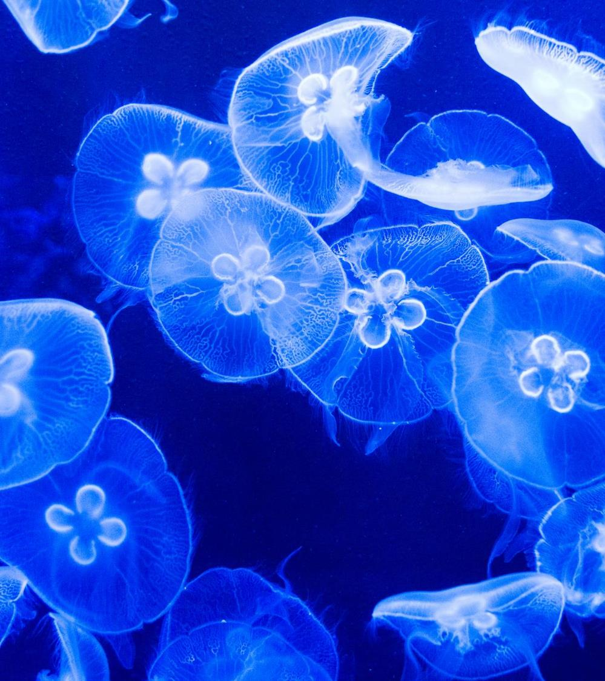
THANK YOU
BUSM 1500
PP2
Jay Lee

